Slide 1
Digital Audio Signal Processing
DASP
Chapter-3:
Fixed Beamforming
Marc Moonen
Dept. E.E./ESAT-STADIUS, KU Leuven
marc.moonen@kuleuven.be
homes.esat.kuleuven.be/~moonen/

Slide 2
Overview
Introduction & beamforming basics
Data model & definitions
Filter-and-sum beamformer design
Matched filtering
  White noise gain maximization
  Ex: Delay-and-sum beamforming
Superdirective beamforming
  Directivity maximization
Directional microphones (delay-and-subtract)

Slide 3
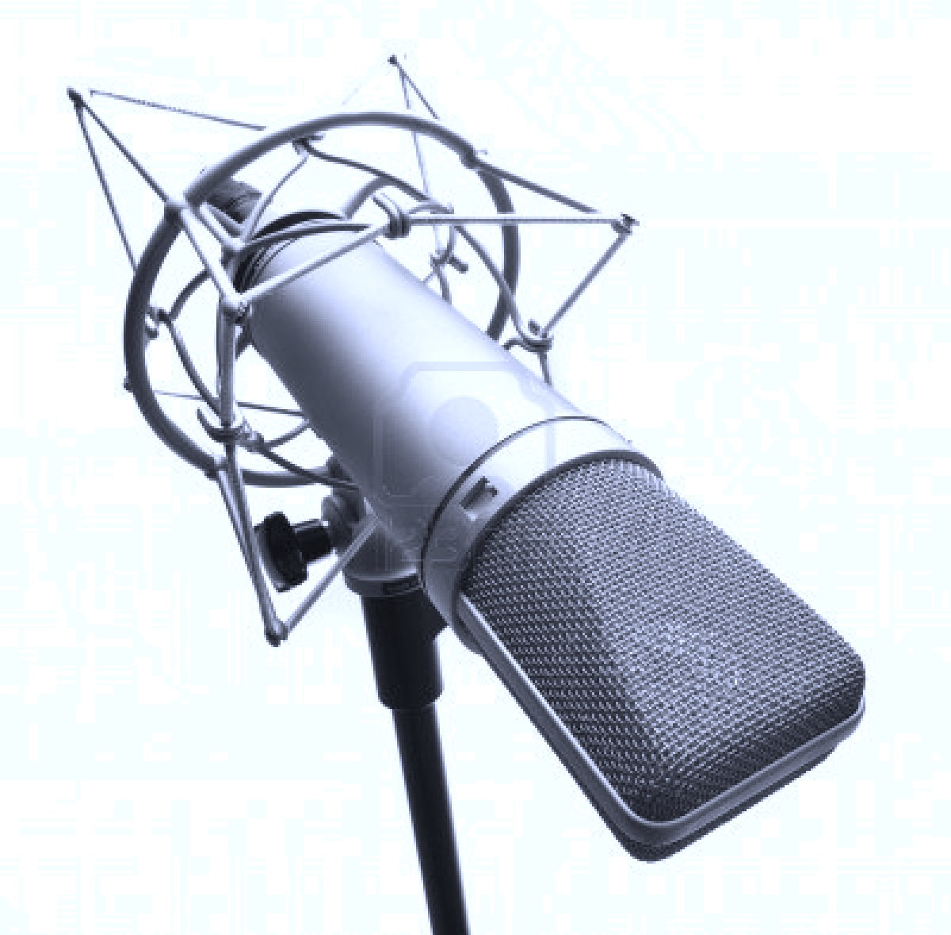
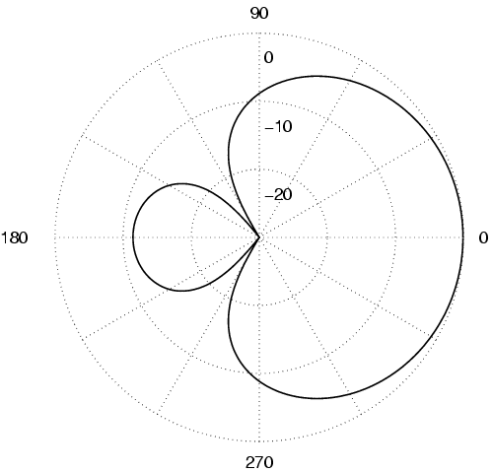
Introduction
Directivity pattern of a microphone
  A microphone (*) is characterized by a `directivity pattern which
  specifies the gain & phase shift that the microphone gives to a
  signal coming from a certain direction (i.e. `angle-of-arrival’)
  In general the directivity pattern is a function of frequency (ω)
  In a 3D scenario `angle-of-arrival’
  is azimuth + elevation angle
  Will consider only 2D scenarios for
  simplicity, with one angle-of arrival (θ),
  hence directivity pattern is H(ω,θ)
  (=angle-dependent transfer function)
  Directivity pattern is fixed and defined
  by physical microphone design
(*) We do digital signal processing, so this includes front-end filtering/A-to-D/..
|H(ω,θ)| for 1 frequency

Slide 4
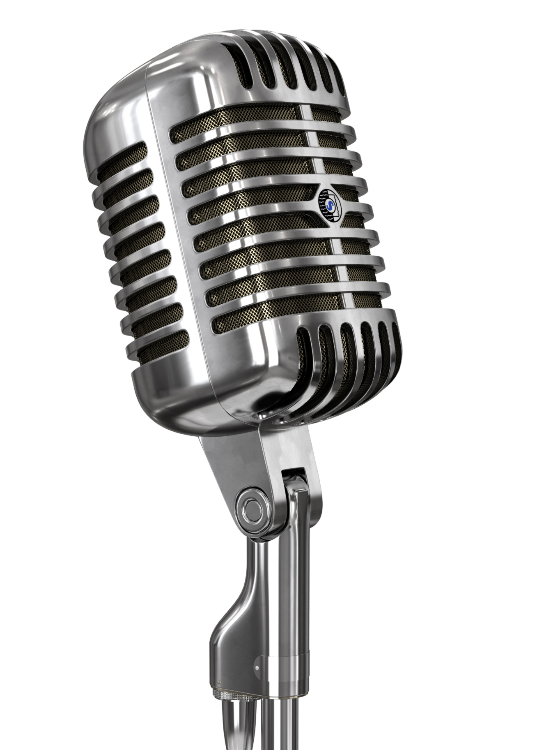
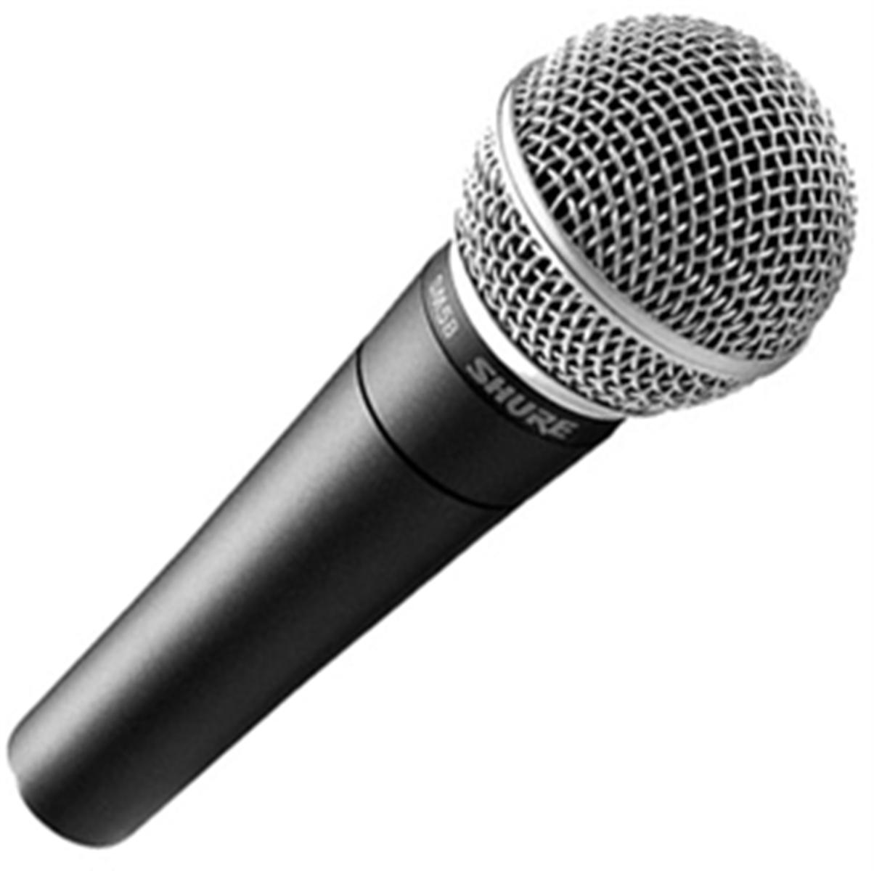
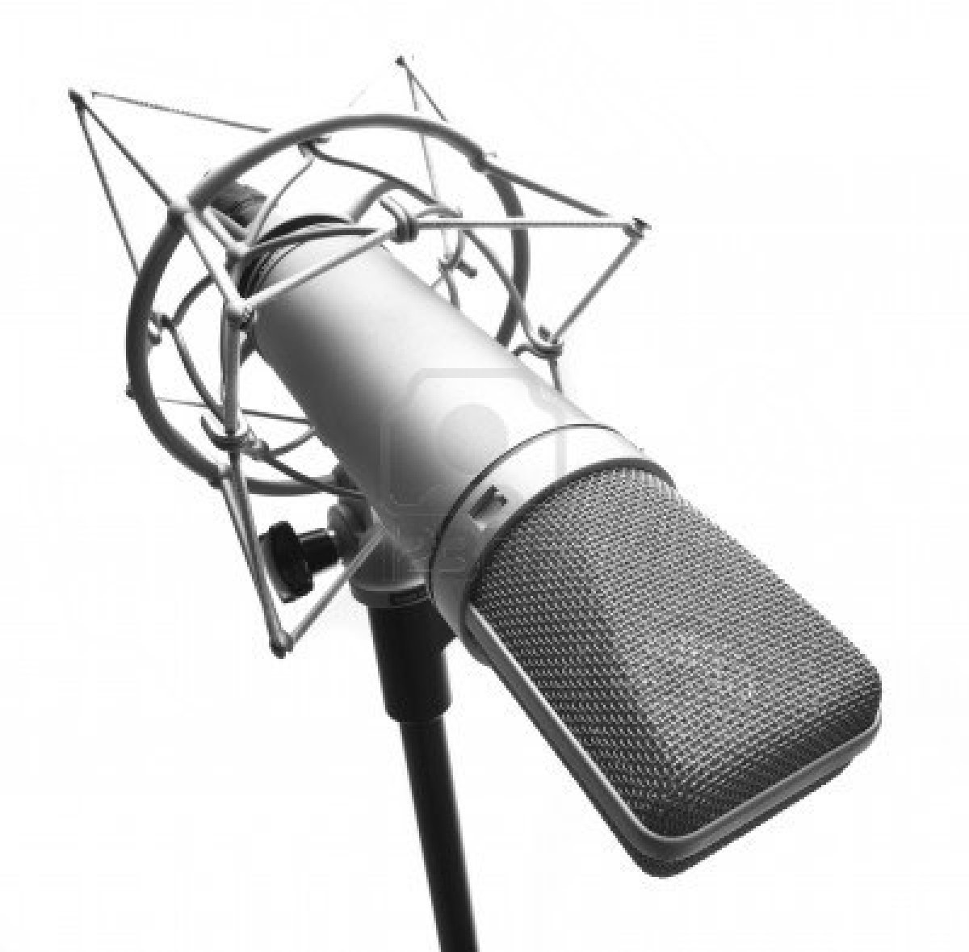
Introduction
Virtual directivity pattern of a microphone array
  By weighting or filtering (=freq. dependent weighting) and then summing signals from different microphones, a (software controlled) virtual directivity pattern (=weigthed sum of individual patterns) can be produced
(=FIR Filters)
+
:

Slide 5
Introduction
This assumes all microphones receive the same signals (so must be in the same position)
However,
in a microphone array different microphones
are in different positions/locations
hence also receive different signals

Slide 6
Introduction
Example : Uniform Linear Array (ULA)
Microphones placed on a line
Uniform inter-micr. distances (d)
Ideal micr. characteristics (H_{m}(ω,θ)=1)
For a far-field source signal
(i.e. plane wave), each microphone
receives the same signal, up
to an angle-dependent delay…
fs=sampling rate
c=propagation speed=343m/s
+
:

Slide 7
Introduction
Beamforming = `spatial filtering’
based on
microphone characteristics (directivity patterns)
AND
microphone array configuration
(`spatial sampling’)
+
:

Slide 8
Introduction
Classification:
  Fixed beamforming: data-independent, fixed filters F_{m}
  e.g. delay-and-sum, filter-and-sum
  Adaptive beamforming: data-dependent filters F_{m}
  e.g. LCMV-beamformer, generalized sidelobe canceler
=This chapter
=Next chapter
+
:

Slide 9
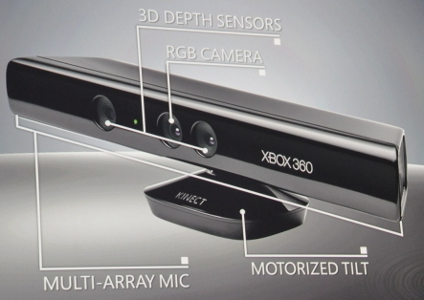
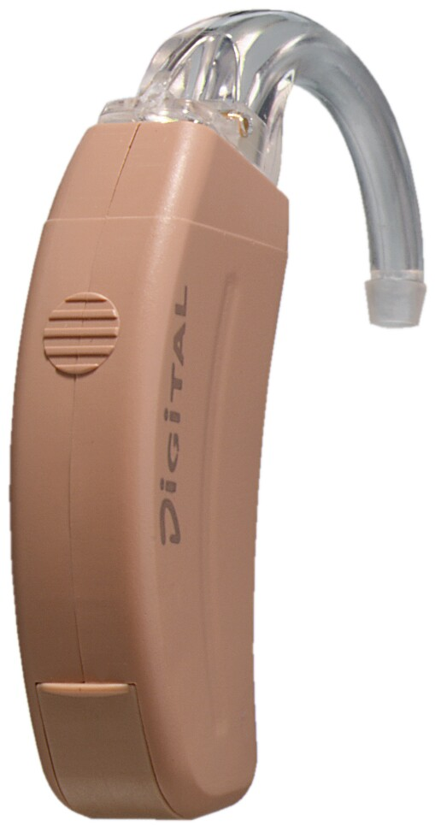
Introduction
Background/history: ideas borrowed from antenna array design and processing for radar & (later) wireless communications
Microphone array processing considerably more difficult than antenna array processing:
  narrowband radio signals versus broadband audio signals
  far-field (plane waves) versus near-field (spherical waves)
  pure-delay environment versus multi-path environment
Applications: voice controlled systems (e.g. Xbox Kinect), speech communication systems, hearing aids,…

Slide 10
Overview
Introduction & beamforming basics
Data model & definitions
Filter-and-sum beamformer design
Matched filtering
  White noise gain maximization
  Ex: Delay-and-sum beamforming
Superdirective beamforming
  Directivity maximization
Directional microphones (delay-and-subtract)

Slide 11
Data model & definitions 1/5
Data model: source signal in far-field (see p.18 for near-field)
Microphone signals are filtered versions of source signal S(ω) at angle θ
Stack all microphone signals (m=1..M) in a vector
d is `steering vector’
Output signal after `filter-and-sum’ is
H instead of T for convenience (**)

Slide 12
Data model & definitions 2/5
Data model: source signal in far-field
If all microphones have the same directivity pattern Ho(ω,θ), steering vector can be factored as…
Will often consider arrays with
ideal omni-directional microphones : Ho(ω,θ)=1
Example : uniform linear array, see p.6
Will use microphone-1 as reference (e.g. defining input SNR):
microphone-1 is used as a reference (=arbitrary)

Slide 13
Data model & definitions 3/5
Definitions:
In a linear array (p.6) : θ =90º=broadside direction
θ = 0º =end-fire direction
Array directivity pattern (compare to p.3)
= `transfer function’ for source at angle θ ( -π<θ< π )
Steering direction
= angle θ with maximum amplification (for 1 freq.)
Beamwidth (BW)
= region around θ_{max} with amplification > (max.amplif - 3dB) (for 1 freq.)

Slide 14
Data model & definitions 4/5
Data model: source signal + noise
Microphone signals are corrupted by additive noise
Define noise correlation matrix as
Will assume noise field is homogeneous, i.e. all diagonal elements of noise correlation matrix are equal (=noise power spectrum) :
Then noise coherence matrix is

Slide 15
Data model & definitions 5/5
Definitions:
Array Gain = improvement in SNR for source at angle θ ( -π<θ< π )
Will consider 2 special cases...
|signal transfer function|^2
(with micr-1 used as reference: d₁ =1)
|noise transfer function|^2

Slide 16
Data model & definitions 5/5
Definitions:
Array Gain = improvement in SNR for source at angle θ ( -π<θ< π )
White Noise Gain =array gain for spatially uncorrelated noise
(e.g. sensor noise)
ps: often used as a measure for robustness

Slide 17
Data model & definitions 5/5
Definitions:
Array Gain = improvement in SNR for source at angle θ ( -π<θ< π )
White Noise Gain =array gain for spatially uncorrelated noise
Directivity =array gain for diffuse noise (=coming from all directions)
DI(ω,θ_{max}) and WNG(ω,θ_{max}) used as performance criterion
..without proof
PS: ω is rad/sample ( -Π≤ω≤Π )
ω.fs is rad/sec
ω.fs/c = ..=2Π/λ is rad/meter
Zero-crossings at d_{j}-d_{i}=(integer).λ/2
for λ=17m (@20Hz)..17mm(@20kHz)

Slide 18
PS: Near-field beamforming
Far-field assumptions not valid for sources close to microphone array
  spherical waves instead of plane waves
  include attenuation of signals
  2 coordinates θ,r (=position q) instead of 1 coordinate θ (in 2D case)
Different steering vector (e.g. with H_{m}(ω,θ)=1 m=1..M) :
e
e=1 (3D)…2 (2D)
with q position of source
p_{ref} position of reference microphone
p_{m} position of m^{th} microphone

Slide 19
PS: Multipath propagation
In a multipath scenario, acoustic waves are reflected against walls, objects, etc..
Every reflection may be treated as a separate source (near-field or far-field)
A more realistic data model is then..
with q position of source and Hm(ω,q), complete transfer function from source position to m-the microphone (incl. micr. characteristic, position, and multipath propagation)
`Beamforming’ aspect vanishes here, see also Lecture-4
(`multi-channel noise reduction’)

Slide 20
Overview
Introduction & beamforming basics
Data model & definitions
Filter-and-sum beamformer design
Matched filtering
  White noise gain maximization
  Ex: Delay-and-sum beamforming
Superdirective beamforming
  Directivity maximization
Directional microphones (delay-and-subtract)

Slide 21
Filter-and-sum beamformer design
Basic: procedure based on page 13
(d(ω,θ) assumed known for all ω,θ)
(FIR Filters)
Array directivity pattern to be matched to given (desired) pattern
over frequency/angle range of interest
Non-linear optimization for FIR filter design (=ignore phase response)
Quadratic optimization for FIR filter design (=co-design phase response)

Slide 22
Filter-and-sum beamformer design
Quadratic optimization for FIR filter design (continued)
  optimal solution is
Kronecker product

Slide 23
Filter-and-sum beamformer design
Design example
M=8
Logarithmic array
N=50
f_{s}=8 kHz

Slide 24
Overview
Introduction & beamforming basics
Data model & definitions
Filter-and-sum beamformer design
Matched filtering
  White noise gain maximization
  Ex: Delay-and-sum beamforming
Superdirective beamforming
  Directivity maximization
Directional microphones (delay-and-subtract)

Slide 25
Matched filtering: WNG maximization
Basic: procedure based on page 17
Maximize White Noise Gain (WNG) for given angle ψ
A priori knowledge/assumptions:
  angle-of-arrival ψ of source signal + corresponding steering vector
  noise scenario = white

Slide 26
Matched filtering: WNG maximization
Maximization in
is equivalent to minimization of noise output power (under
white input noise), subject to unit response for angle ψ, i.e. (**)
Optimal solution (`matched filter’) is...
FIR approximation

Slide 27
Matched filtering example: Delay-and-sum
Basic: Microphone signals are delayed and then summed together
Fractional delays implemented with truncated interpolation filters (=FIR)
Consider array with ideal omni-directional microphones
Then array can be steered to angle ψ :
Hence (for ideal omni-dir. micr.’s) this is matched filter solution

Slide 28
Matched filtering example: Delay-and-sum
ideal omni-dir. micr.’s
Array directivity pattern H(ω,θ):
=destructive interference
=constructive interference
White noise gain :
(independent of ω)
For ideal omni-dir. micr. array, delay-and-sum beamformer provides
WNG equal to M for all freqs (in the direction of steering direction ψ).

Slide 29
Matched filtering example: Delay-and-sum
ideal omni-dir. micr.’s
Array directivity pattern H(ω,θ) for uniform linear array:
H(ω,θ) has sinc-like shape and is frequency-dependent
M=5 microphones
d=3 cm inter-microphone distance
ψ=60° steering direction
f_{s}=16 kHz sampling frequency
wavelength=4cm
ψ=60°

Slide 30
Matched filtering example: Delay-and-sum
ideal omni-dir. micr.’s
Array directivity pattern H(ω,θ) for uniform linear array:
H(ω,θ) has sinc-like shape and is frequency-dependent
=endfire
wavelength=4cm
ψ=60°

Slide 31
Matched filtering example: Delay-and-sum
ideal omni-dir. micr.’s
For an ambiguity, called spatial aliasing, occurs..
  This is analogous to time-domain aliasing where now the spatial sampling (=d) is too large.
Aliasing does not occur (for any ψ) if
M=5 microphones
d=8 cm inter-microphone distance
ψ=60° steering direction
f_{s}=16 kHz sampling frequency

Slide 32
Matched filtering example: Delay-and-sum
ideal omni-dir. micr.’s
Ignore the

Slide 33
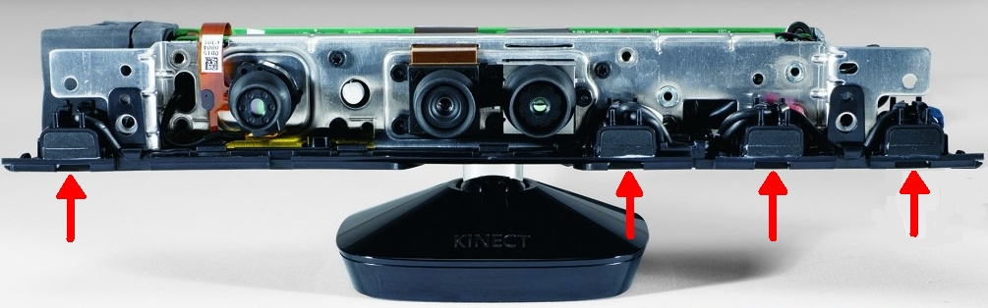
Matched filtering example: Delay-and-sum
ideal omni-dir. micr.’s
Beamwidth for a uniform linear array:
hence large dependence on # microphones, distance (compare p.29 & 31) and frequency (e.g. BW infinitely large at DC) (compare to p.23)
Array topologies:
  Uniformly spaced arrays
  Nested (logarithmic) arrays (small d for high ω, large d for small ω)
  2D- (planar) / 3D-arrays
with e.g. ν=1/sqrt(2) (-3 dB)

Slide 34
Overview
Introduction & beamforming basics
Data model & definitions
Filter-and-sum beamformer design
Matched filtering
  White noise gain maximization
  Ex: Delay-and-sum beamforming
Superdirective beamforming
  Directivity maximization
Directional microphones (delay-and-subtract)

Slide 35
Super-directive beamforming : DI maximization
Basic: procedure based on page 17
Maximize Directivity (DI) for given angle ψ
A priori knowledge/assumptions:
  angle-of-arrival ψ of source signal + corresponding steering vector
  noise scenario = diffuse

Slide 36
Super-directive beamforming : DI maximization
Maximization in
is equivalent to minimization of noise output power (under
diffuse input noise), subject to unit response for angle ψ , i.e. (**)
Optimal solution (‘super-directive beamformer’) obtained as...
FIR approximation

Slide 37
Super-directive beamforming : DI maximization
ideal omni-dir. micr.’s
Directivity patterns for end-fire steering (ψ=0):
Superdirective beamformer has highest DI, but very poor WNG
(at low frequencies, where diffuse noise coherence matrix becomes ill-conditioned)
hence problems with robustness (e.g. sensor noise) !
M=5
d=3 cm
f_{s}=16 kHz
DI=M ²⁼25
PS:
diffuse noise ≈
white noise for
high frequencies
(cfr. ω➔Π and
c/fs=λmin/2≈min(dj-di)
in diffuse noise
coherence matrix)
WNG=M= 5
DI=WNG=5
Maximum directivity=M.M obtained for end-fire steering and for frequency->0 (without proof)

Slide 38
Overview
Introduction & beamforming basics
Data model & definitions
Filter-and-sum beamformer design
Matched filtering
  White noise gain maximization
  Ex: Delay-and-sum beamforming
Superdirective beamforming
  Directivity maximization
Directional microphones (delay-and-subtract)

Slide 39

Differential microphones : Delay-and-subtract
First-order differential microphone = directional microphone
  2 closely spaced microphones, where one microphone signal is delayed
  (=hardware) and then subtracted from the other micropone signal
Array directivity pattern:
  First-order high-pass frequency dependence (jω)
  P(θ) = freq.independent (!) directional response
  0 ≤ α₁ ≤ 1 : P(θ) is scaled cosine, shifted up with α₁
  such that θ_{max} = 0º (=end-fire) and P(θ_{max} )=1
Continuous-time
system freq.resp.
ω = rad/sec
ωd/c <<π, ωτ <<π
$$τ$$

Slide 40
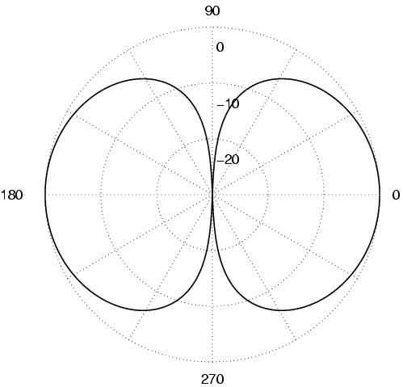
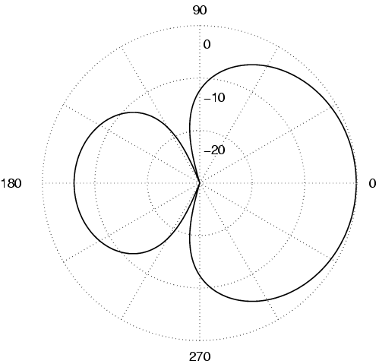
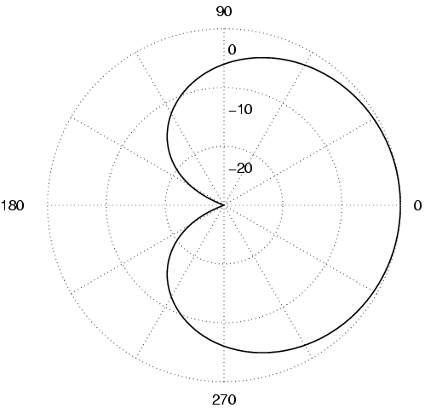
Differential microphones : Delay-and-subtract
Types: dipole, cardioid, hypercardioid, supercardioid (HJ84)
=broadside
=endfire
Dipole:
α₁= 0 (τ=0) zero at 90º
DI=4.8dB
Hypercardioid:
α₁= 0.25
zero at 109º
highest DI=6.0dB
Supercardioid:
α₁=
zero at 125º,
DI=5.7 dB
highest front-to-back ratio
Cardioid:
α₁= 0.5 zero at 180º
DI=4.8dB

